Slide 1


JavaScript Basics
Asynchronous
Javascript
Promises, Scheduling

Slide 2
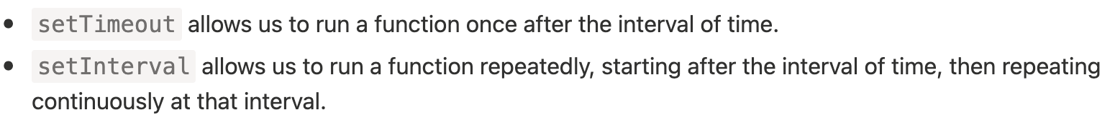
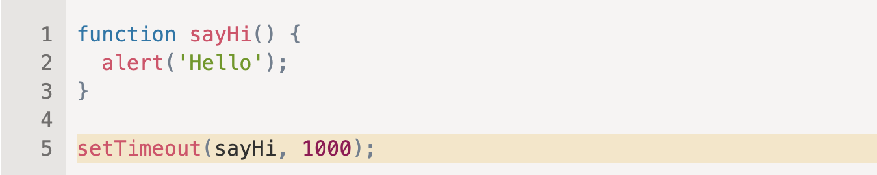
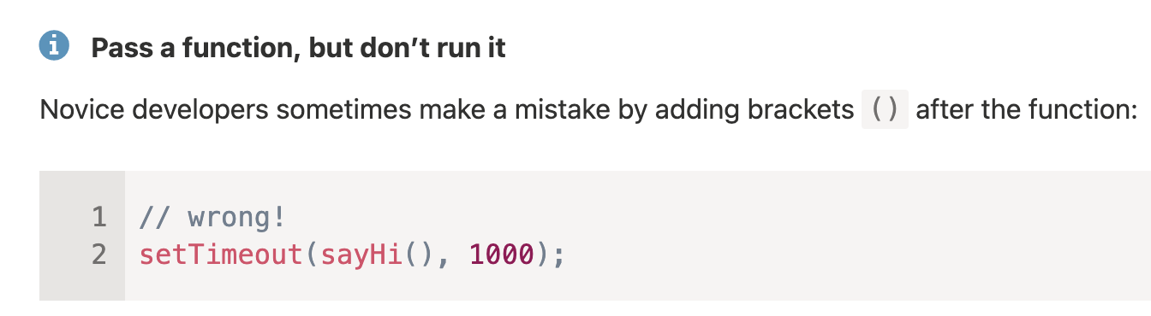
Scheduling

Slide 3
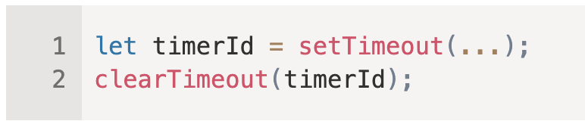
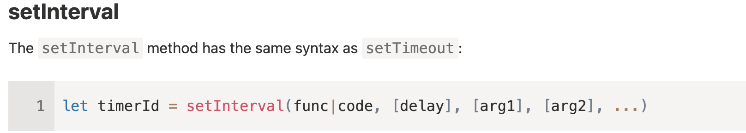

Slide 4
Tasks
Write a function printNumbers(from, to) that outputs a number every second, starting from from and ending with to.
Create StopWatch (with start, stop, pause buttons);

Slide 5
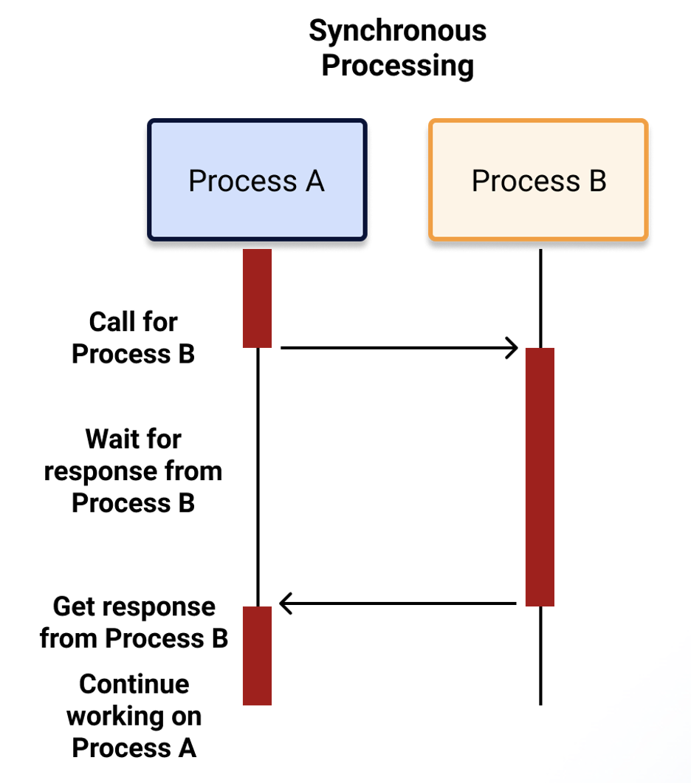
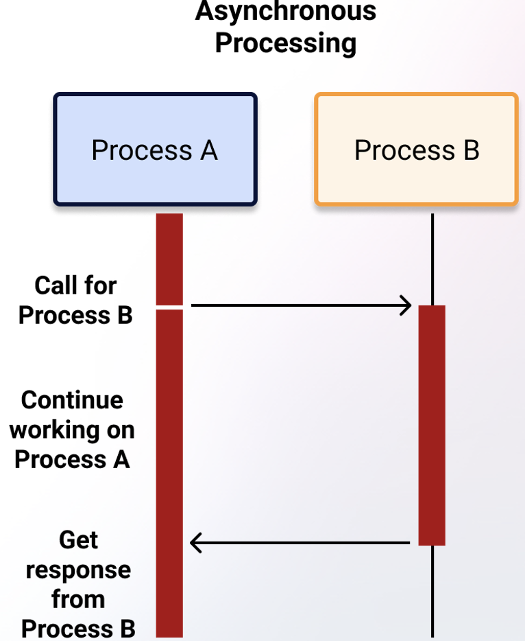
JavaScript Thread is single-threaded by
default used to run a script in the web
application, perform layout and
garbage collection.
Being single-threaded is to execute only
a single set of instructions at any time
in the process.

Slide 6
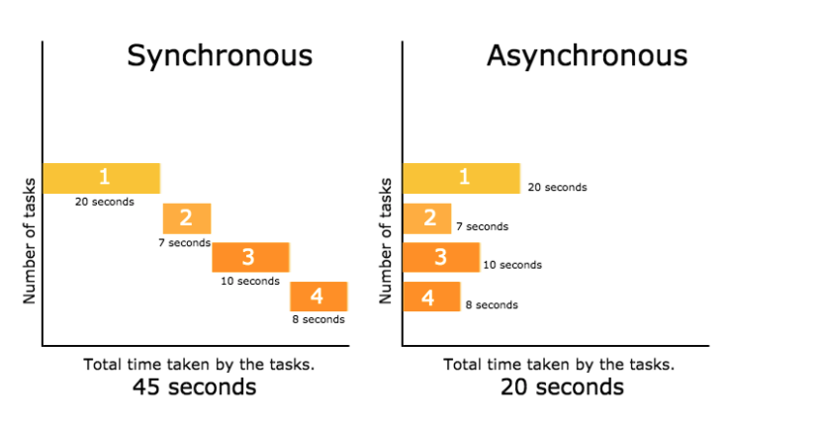
JavaScript is a synchronous, blocking, single-threaded language.
That just means that only one operation can be in progress at a time.

Slide 7
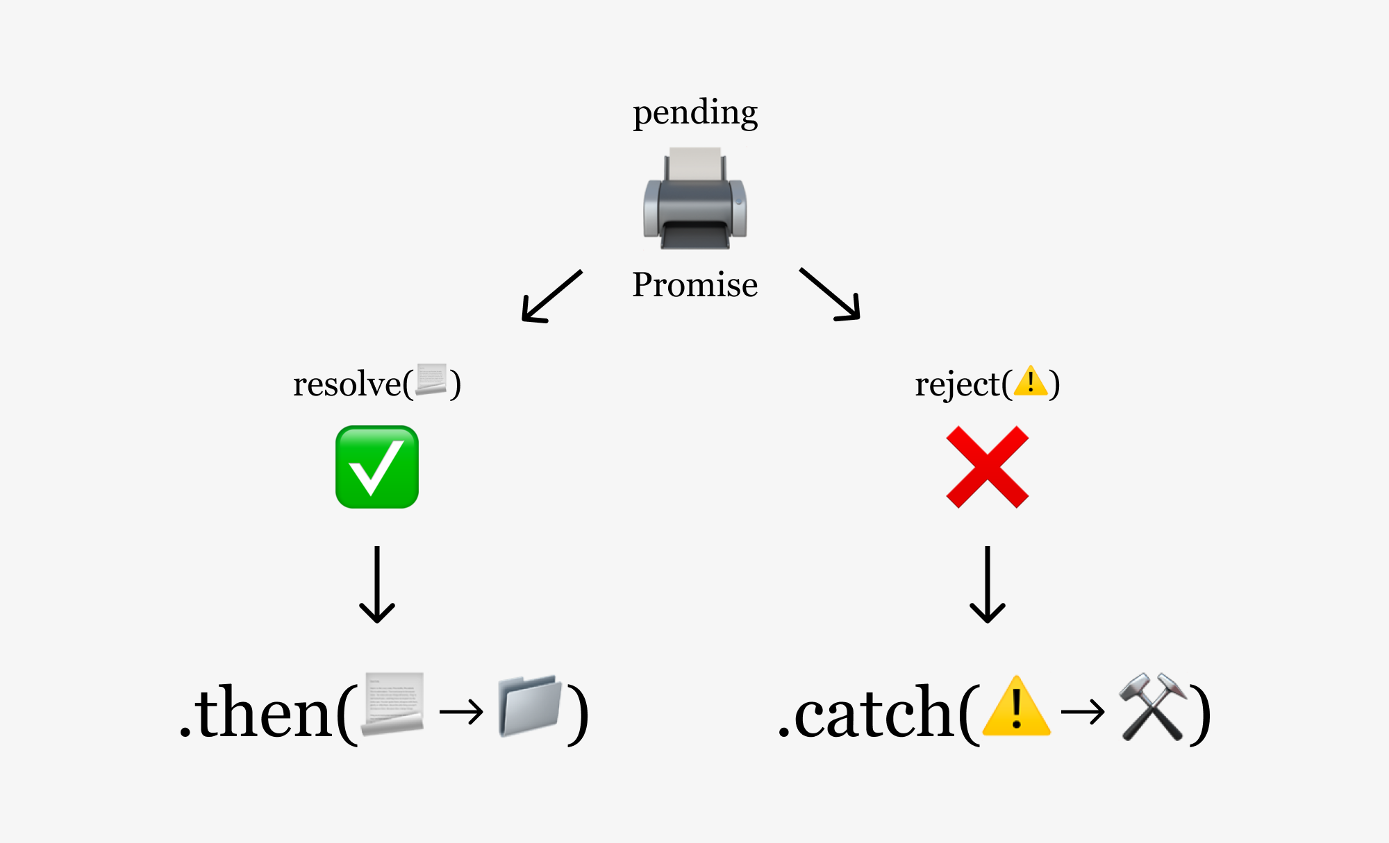
Promise

Slide 8
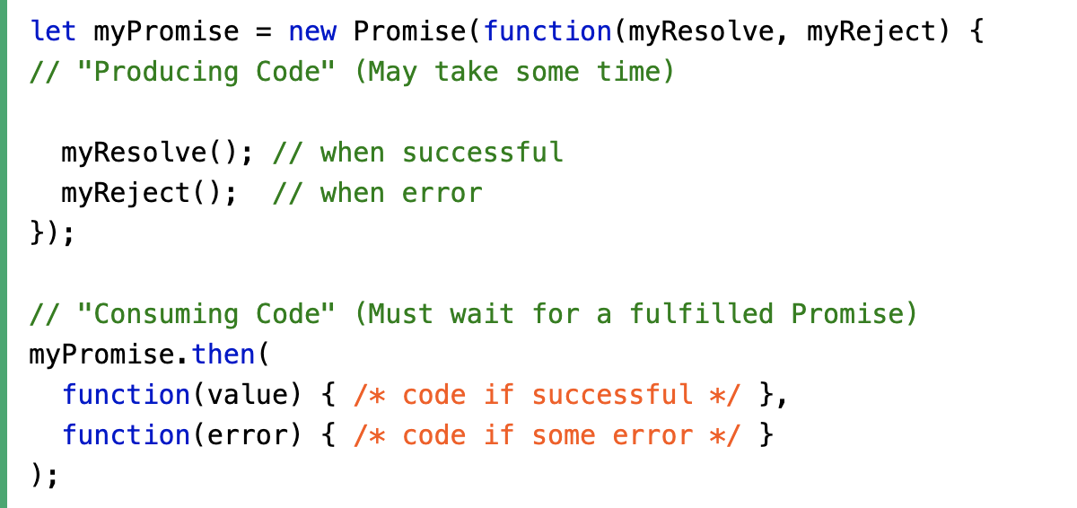
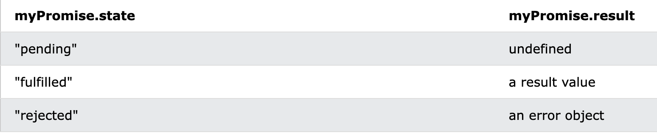
Promise Syntax

Slide 9
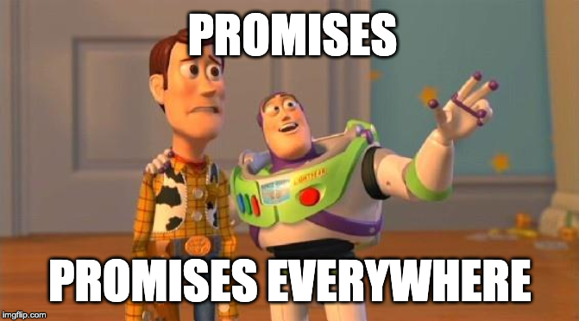

Slide 10
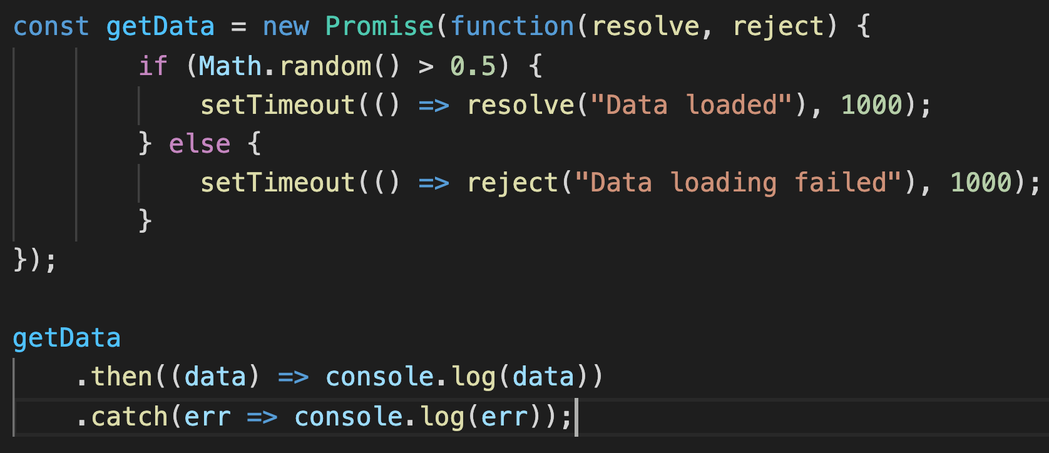
Example

Slide 11
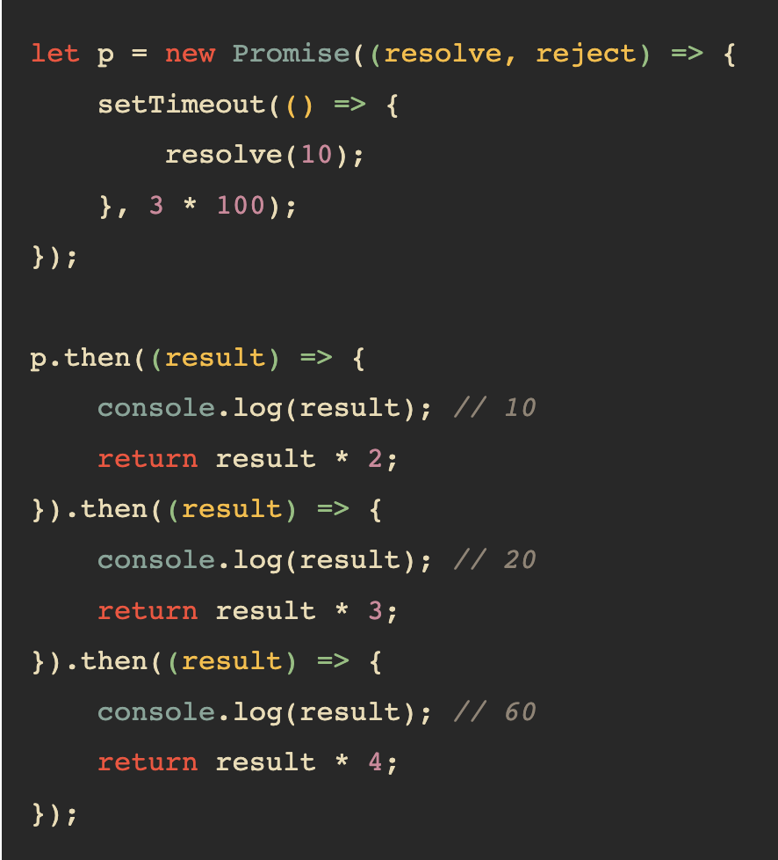
Promise Chaining

Slide 12
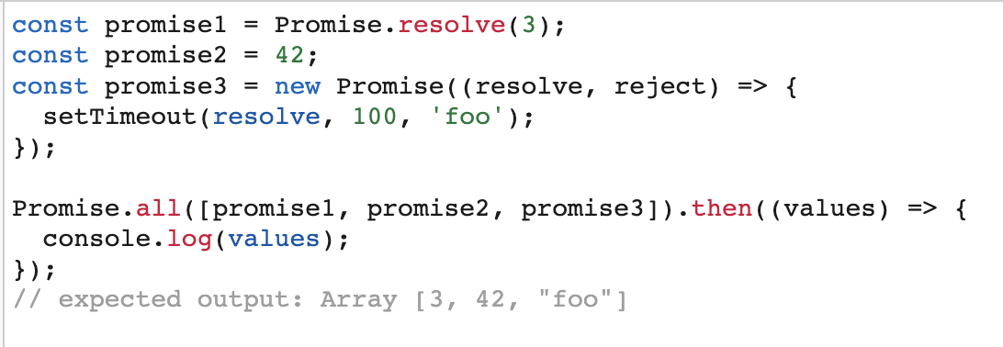
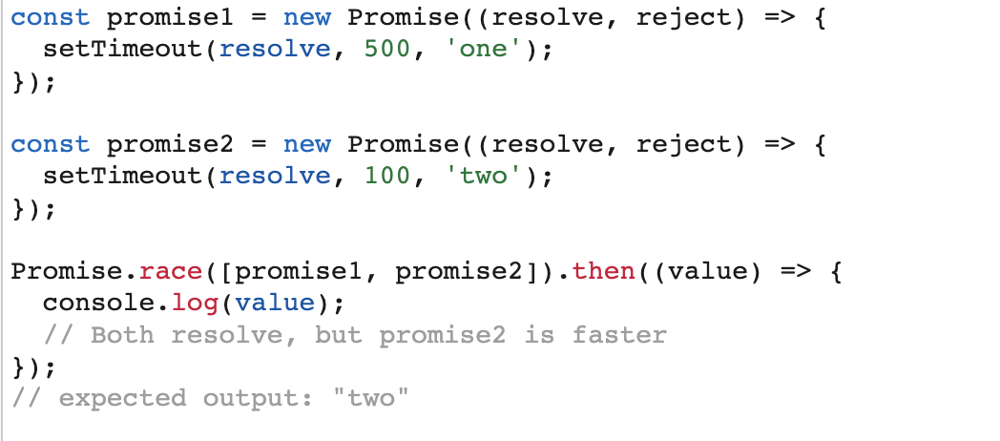
Promise.all()
Promise.race()

Slide 13
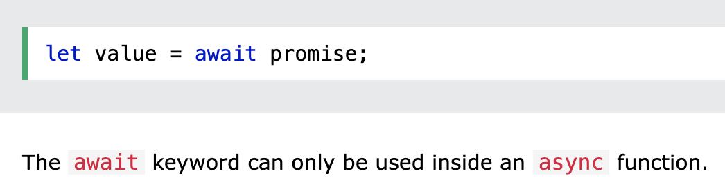
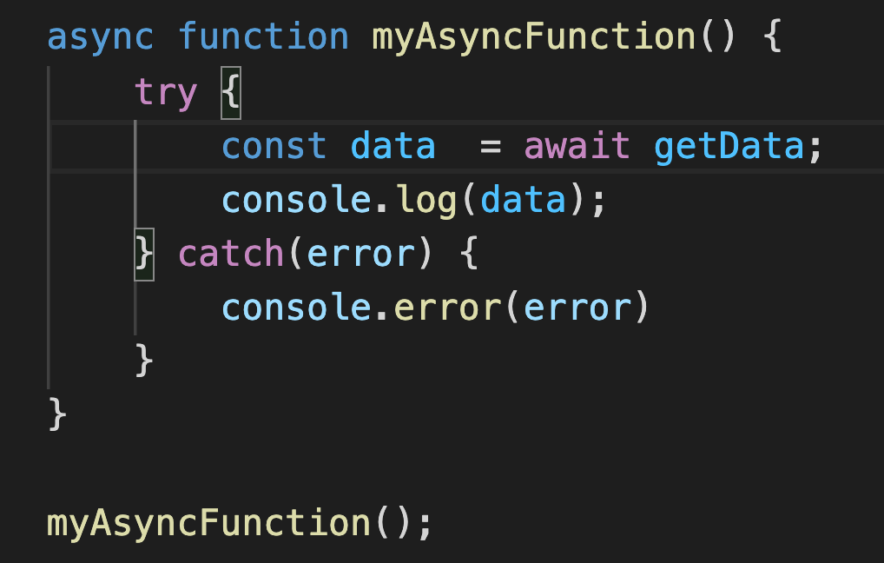
Async/Await

Slide 14
Tasks
The function job must return a promise object .The promise must resolve itself 2 seconds after the call to job and must provide hello world in the data
Create function which receive a data and returns a Promise
2.1. If data is not a number, return a promise rejected instantly and give the d ata "error" (in a string).
2.2. If data is an odd number, return a promise resolved 1 second later and give the data "odd" (in a string).
2.3. If data is an even number, return a promise rejected 2 seconds later and give the data "even" (in a string).
Create async `order()` for CoffeShop class

